Slide 1
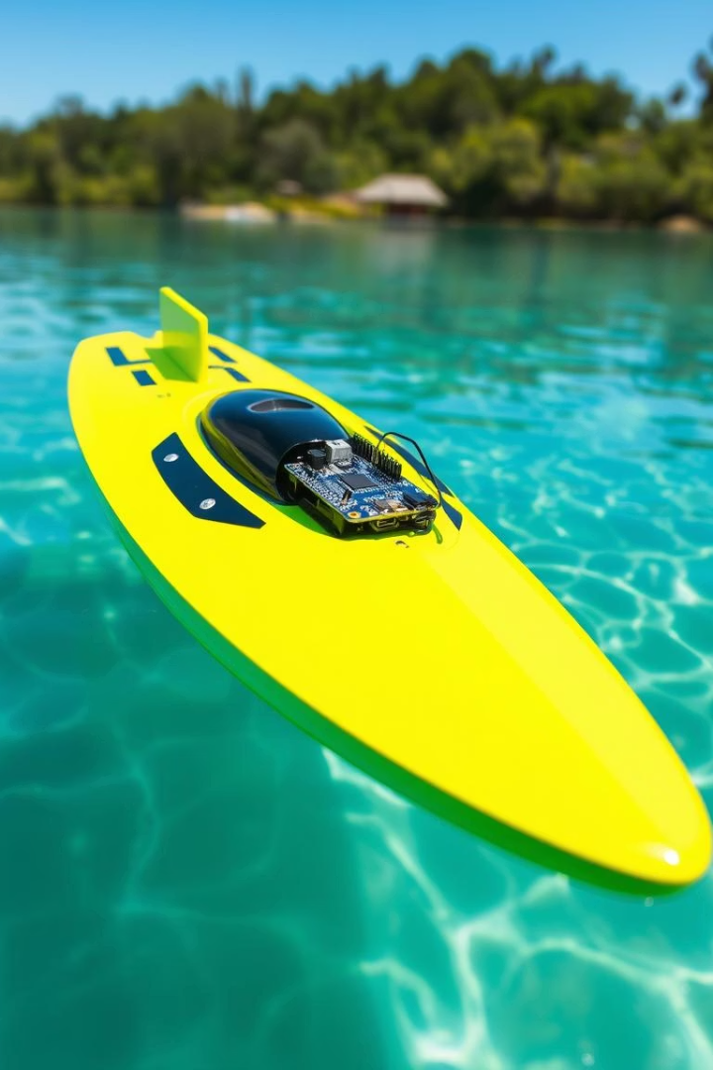

Bluetooth-Controlled RC Boat
Using Arduino Nano and HC-05 Bluetooth Module for wireless control.
Notes:
1

Slide 2

Green University of Bangladesh
Course Title : EEE LAB
Course Code: CSE-202 Department :CSE
Section : 232-D1 Batch: 232
Submitted by
Md. Rahanul Islam
ID: 232002089
Tasnima Tahrim Turna
ID: 232002273
Sabia Tiaba
ID: 232002129
Submitted to
Name: Md. Nayeem sarkar
Lecturer
Dept. of CSE
Green University of Bangladesh
Notes:
2

Slide 3

Outline
Introduction
Objective
Project background and importance of wireless control.
Goals and expected outcomes of the RC boat project.
Components Used
Working Methodology
Hardware parts and modules included.
Stepwise approach to build and test the system.
System Overview
Circuit Design
Architecture and component interaction.
Wiring and signal flow details.
Observation
Challenges Faced
Results and performance insights.
Obstacles and troubleshooting experience.
Future Improvement
Conclusion
Potential enhancements and upgrades.
Summary and final thoughts.
Notes:
3

Slide 4
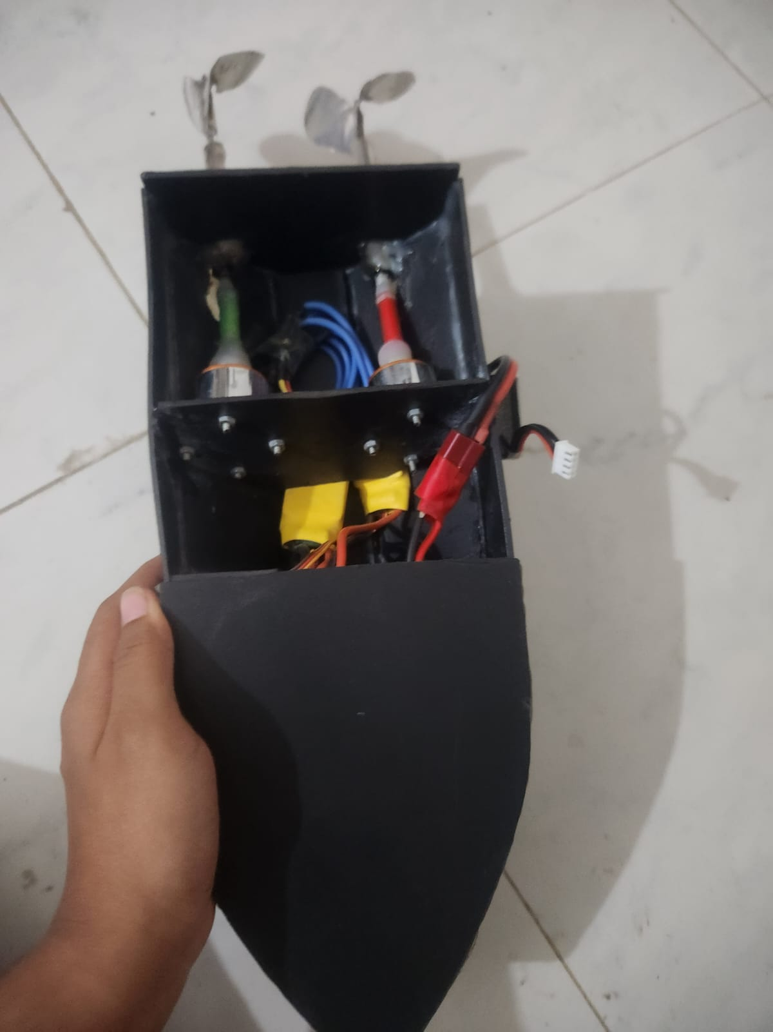
Introduction
This RC boat project allows wireless remote control via Bluetooth.
Key functions include motor control and real-time responsiveness.
Embedded system design is critical for seamless operation.
Notes:
4

Slide 5

Motivation
Exploring wireless control enhances innovation in marine robotics.
Combining embedded systems with Bluetooth tech fosters learning and prototyping.
Notes:
5

Slide 6
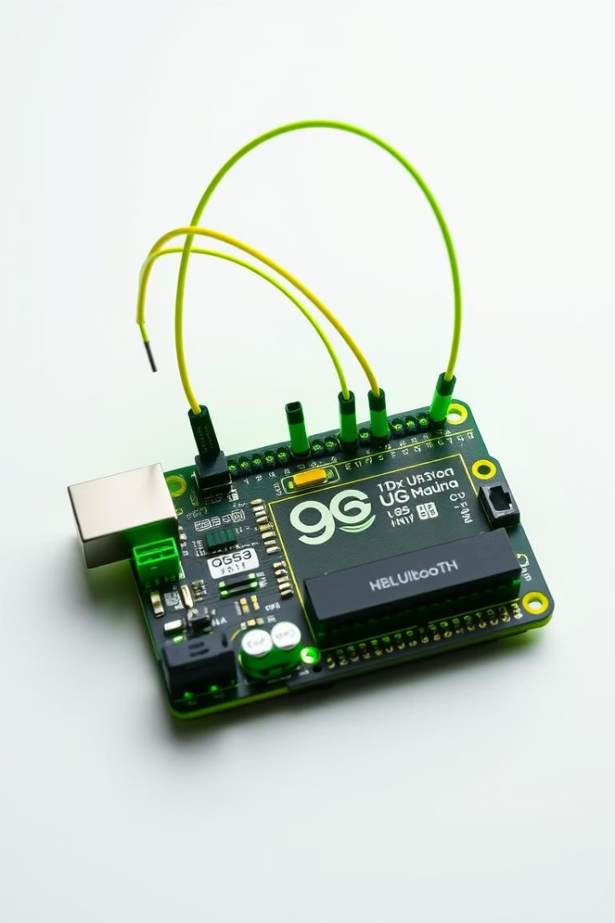
Objective
Wireless Control
Component Integration
Enable boat navigation using smartphone Bluetooth commands.
Combine Arduino Nano, ESC, brushless motor, and power unit.
System Development
Create reliable control protocol and power management.
Notes:
6

Slide 7
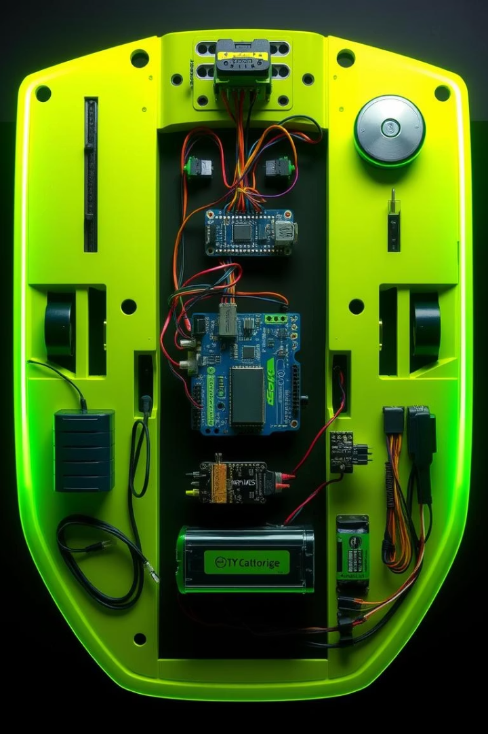







Components Used
Arduino Nano
HC-05 Bluetooth Module
11.1V Li-Po Battery
Brushless Motor (1000KV)
30A ESC
LM2596 Buck Converter
Jumper Wires & Breadboard
Notes:
8

Slide 8

Software Overview
The software integrates Bluetooth communication and motor control.
Arduino Nano firmware handles signal processing and PWM outputs.
Bluetooth Communication
PWM Signal Generation
Battery Management
Translates commands into precise motor speed adjustments via ESC.
Monitors power levels to optimize efficiency and prevent shutdown.
Receives commands wirelessly from smartphone app for real-time control.
Notes:
9

Slide 9
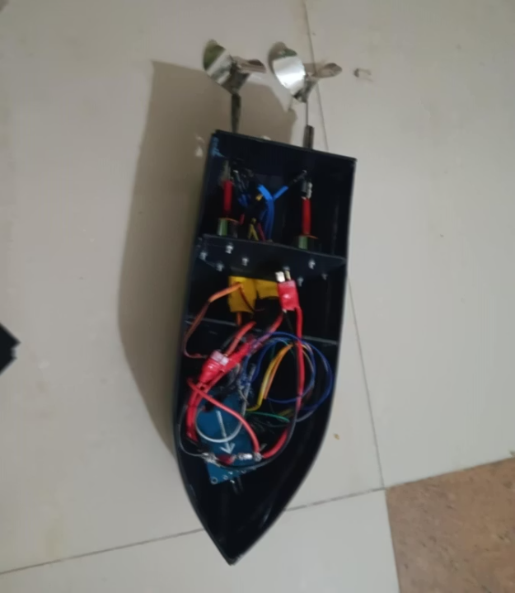
Working Methodology
Assemble circuit parts precisely on a breadboard platform.
Configure buck converter to output regulated 5V power.
Upload Bluetooth control code to Arduino Nano.
Connect smartphone to HC-05 module for remote commands.
Test motor responses through Bluetooth mobile application.
Notes:
10

Slide 10
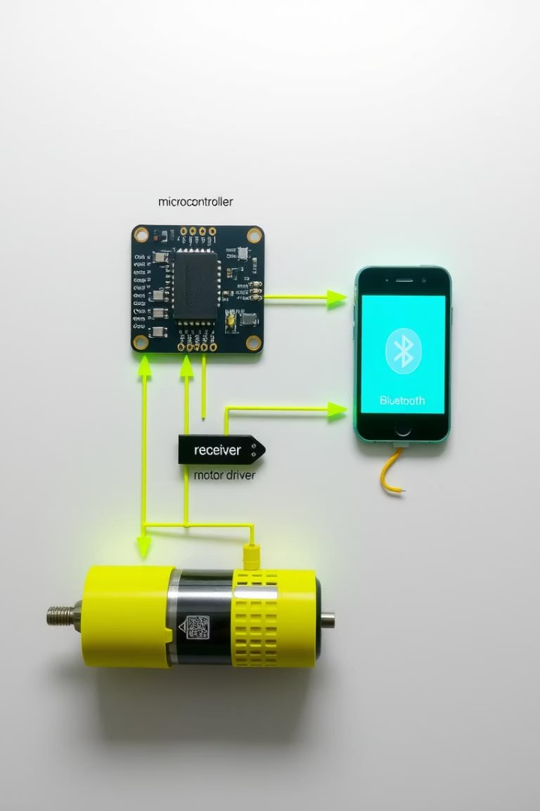
System Overview
Bluetooth Communication
Smartphone sends control signals to HC-05 module.
Arduino Nano Processing
Interprets signals and generates PWM outputs for ESC.
Motor Drive
Brushless motor speed controlled by ESC via PWM.
Power Management
LM2596 converter regulates voltage from Li-Po battery.
Notes:
11

Slide 11
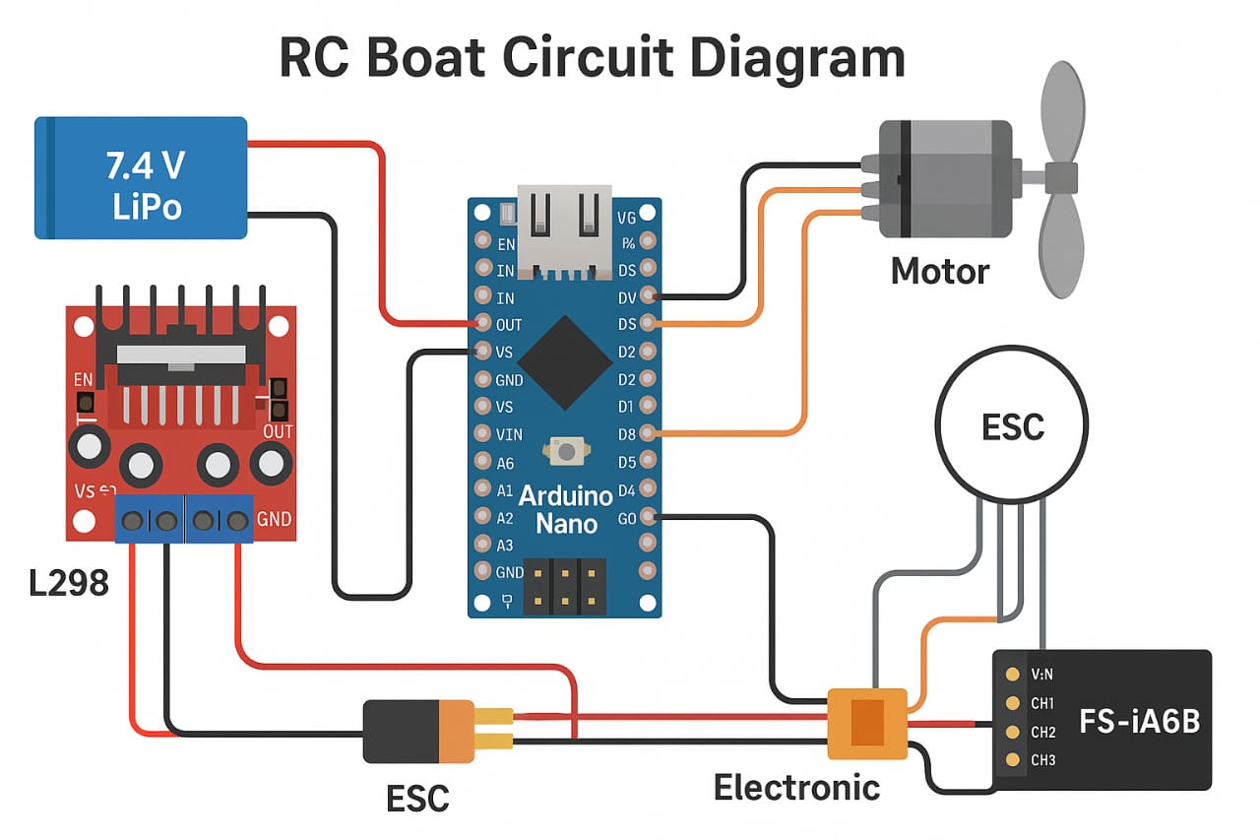
Circuit Design
HC-05 TX connected to Arduino RX, RX to TX
ESC signal wire linked to Arduino PWM pin
LM2596 regulates battery voltage to 5V for Arduino
Brushless motor powered from ESC and battery supply
Notes:
12

Slide 12
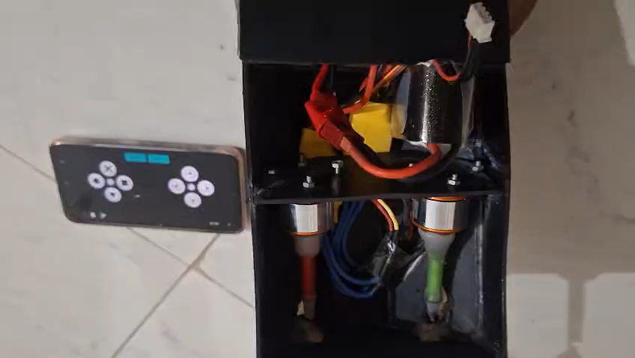
Applications
Educational Robotics
Automated Water Vehicles
Lab Demonstrations
Showcase embedded system concepts in practical settings.
Hands-on learning for embedded systems and wireless tech.
Prototype development for unmanned marine devices.
Notes:
7

Slide 13
Future Improvements
Enhanced Bluetooth Range
Improved Power Efficiency
Expand control distance for better outdoor usability.
Optimize battery life with advanced power management.
Advanced Sensor Integration
User Interface Upgrade
Add GPS and obstacle detection for autonomous navigation.
Develop a more intuitive smartphone control app.
Notes:
13

Slide 14
Project Limitations
Understanding the current constraints helps direct future enhancements.
This project faces range limits and basic sensor integration challenges.
Bluetooth Range
Power Constraints
Control distance is limited to a few meters around the boat.
Battery life restricts operation time under continuous usage.
Sensor Support
User Interface
Currently lacks advanced sensors for autonomous navigation.
Mobile app interface could be more intuitive and responsive.
Notes:
14

Slide 15
Conclusion
Effective Wireless Control
Seamless Component Integration
Practical Applications
Ideal for educational projects and prototype marine vehicles.
Bluetooth enables reliable and responsive boat navigation.
Arduino, ESC, motor, and power units work harmoniously.
Notes:
15

Slide 16

Thank You
We appreciate your time and interest in our Bluetooth-controlled RC boat project.
Feel free to ask questions or provide feedback.
Notes:
16

